Slide 1
SpringDoc OpenAPI
Swagger was released in 2011 to document rest API. It provides an API which is consumed by Swagger UI
In 2016,Swagger decided to make this API opensource, so they renamed it as OpenAPI.
Springdoc-openapi java library helps to automate the generation of API documentation using spring boot projects. It works by examining an application at runtime to infer API semantics based on spring configurations, class structure and various annotations.
We need to add the following dependency in pom.xml
To launch Swagger UI, we will use thr url:- http://localhost:8080/swagger-ui/index.html
<dependency>
<groupId>org.springdoc</groupId>
<artifactId>springdoc-openapi-ui</artifactId>
<version>1.6.3</version>
</dependency>

Slide 2
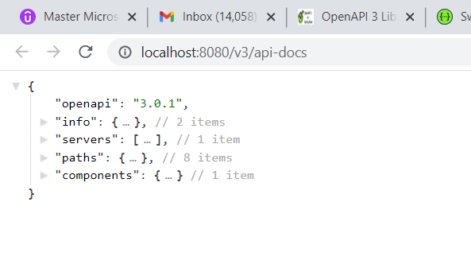
Structure of swagger UI message:-
Current latest version of openAPI is 3.0.1
We will view individual components on next page

Slide 3
1. info :-- shows version
"info": {"title": "OpenAPI definition","version": "v0"}
2. servers
"servers": [{"url": "http://localhost:8080","description": "Generated server url"}]
3.paths : show al endpoints
"/GetAllUsers": {
"get": {
"tags": [
"user-resource"
],
"operationId": "getAllUser",
"responses": {
"200": {
"description": "OK",
"content": {
"*/*": {
"schema": {
"type": "array",
"items": {
"$ref": "#/components/schemas/User"

Slide 4
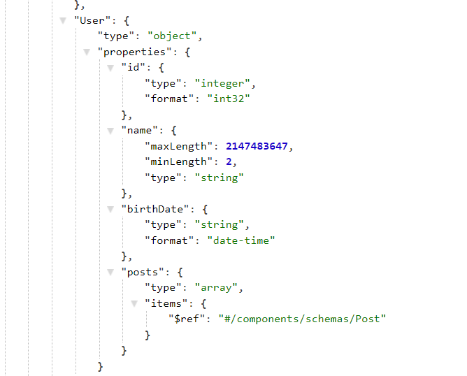
4.Components
Contains Schemas of Data Types

Slide 5
